Slide 1



Enterprise Programming (303105309)

Slide 2
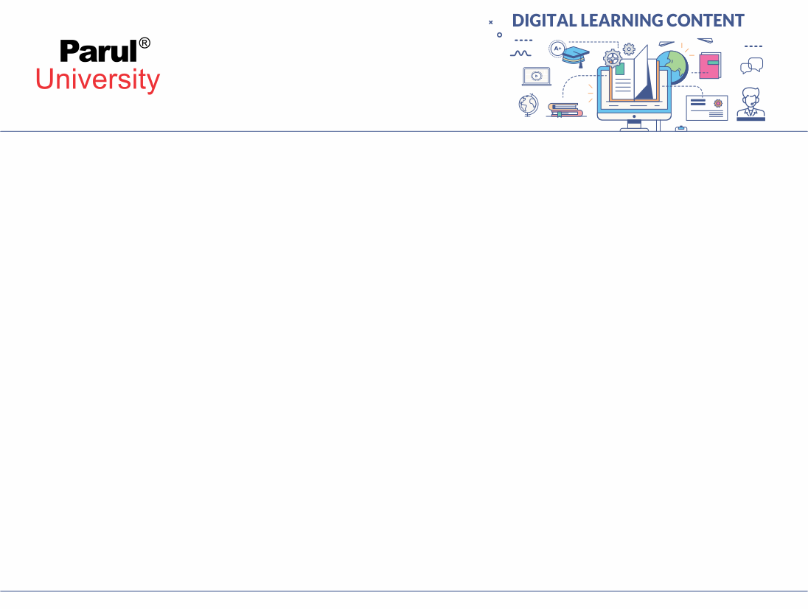

CHAPTER-1
Foundation of Enterprise Programming

Slide 3
Foundation of Enterprise Programming
Enterprise programming is the backbone of large-scale business applications. It focuses on building robust, scalable, and maintainable software systems that handle complex workflows, large data volumes, and integration across services.
This foundation introduces you to the essential tools, technologies, and concepts that support enterprise-grade Java development — before diving into frameworks like Spring, Hibernate, or JEE.
Why Is It Important?
Enterprises need modular, secure, and efficient systems.
Applications often interact with databases, servers, APIs, and third-party tools.
A solid foundation ensures you can understand, build, and maintain such systems professionally.

Slide 4
Core Building Blocks You'll Learn
XML | For configuration, data interchange, and service messaging
JDBC | To connect and interact with relational databases
JDBC with MySQL/Oracle | Real-world database communication
Maven | Dependency management and build automation tool
POM.xml | The heart of Maven-based project configuration
Eclipse IDE | Industry-grade IDE for Java enterprise development

Slide 5
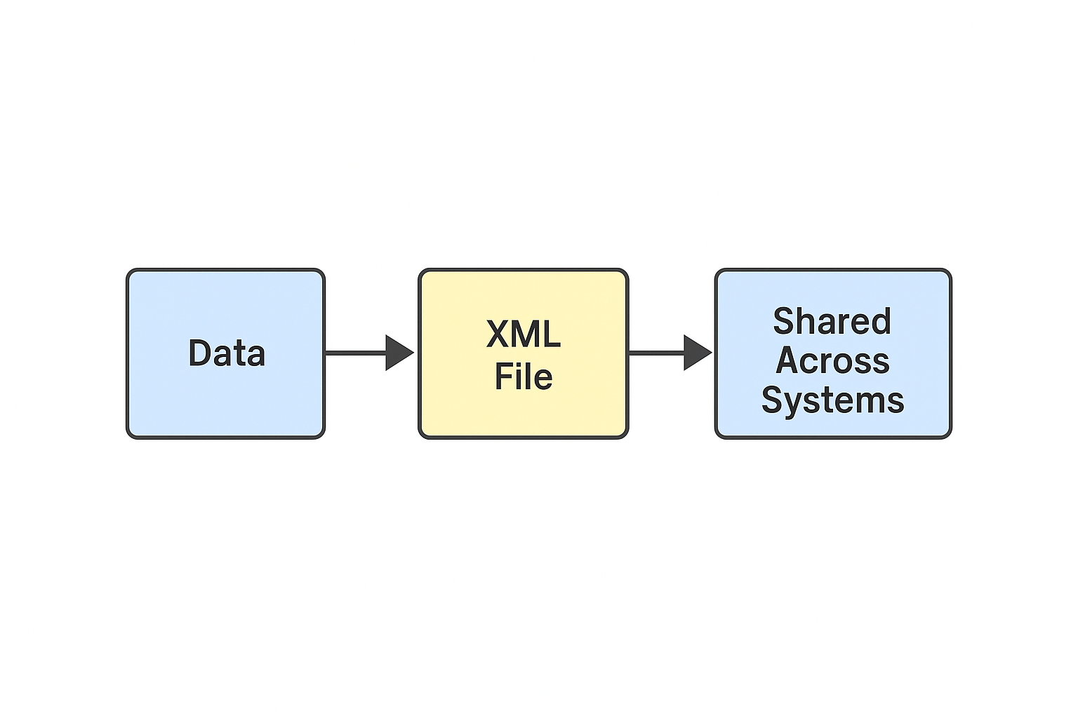
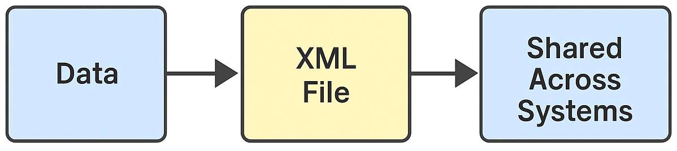
XML basics
What is XML?
XML stands for eXtensible Markup Language
Used to store and transport data
Platform-independent and system-neutral
Both human-readable and machine-readable

Slide 6
Features and Syntax of XML
Key Features of XML
Self-descriptive structure (custom tags)
Tree-like hierarchical data format
Extensible — define your own elements
Platform and language independent
Used in configuration and communication
XML Syntax Overview
Tags must be properly nested and closed
Case-sensitive
One root element only
Attribute usage

Slide 7
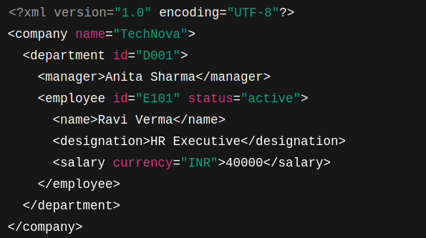
XML Structure

Slide 8
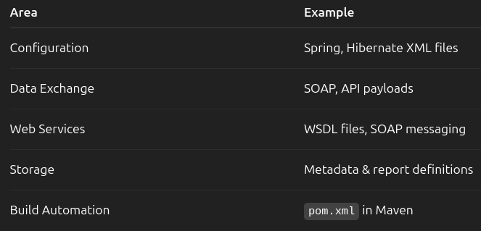
Uses of XML in Enterprise
Where XML is Used in Industry

Slide 9
Real-world XML Links
https://www1.cbn.com/rss-cbn-articles-cbnnews.xml https://www1.cbn.com/app_feeds/rss/news/rss.php?section=us https://feeds.bbci.co.uk/news/business/rss.xml https://thewest.com.au/rss https://www.dailytelegraph.com.au/news/breaking-news/rss

Slide 10
JDBC and JDBC Architecture
What is JDBC?
JDBC stands for Java Database Connectivity, which is a standard Java API for database-independent connectivity between the Java programming language and a wide range of databases.
The JDBC library includes APIs for each of the tasks mentioned below that are commonly associated with database usage.
Making a connection to a database.
Creating SQL or MySQL statements.
Executing SQL or MySQL queries in the database.
Viewing & Modifying the resulting records.

Slide 11
JDBC and JDBC Architecture
Fundamentally, JDBC is a specification that provides a complete set of interfaces that allows for portable access to an underlying database. Java can be used to write different types of executables, such as −
Java Applications
Java Applets
Java Servlets
Java Server Pages (JSPs)
Enterprise Java Beans (EJBs).
All of these different executables are able to use a JDBC driver to access a database, and take advantage of the stored data.

Slide 12
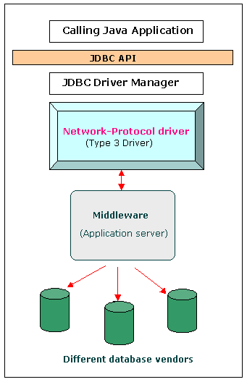
JDBC API
The JDBC API supports both two-tier and three-tier processing models for database access but in general, JDBC Architecture consists of two layers −
JDBC API − This provides the application-to-JDBC Manager connection.
JDBC Driver API − This supports the JDBC Manager-to-Driver Connection.
The JDBC API uses a driver manager and database-specific drivers to provide transparent connectivity to heterogeneous databases.
The JDBC driver manager ensures that the correct driver is used to access each data source. The driver manager is capable of supporting multiple concurrent drivers connected to multiple heterogeneous databases.

Slide 13
Common JDBC Components
DriverManager − This class manages a list of database drivers. Matches connection requests from the java application with the proper database driver using communication sub protocol. The first driver that recognizes a certain subprotocol under JDBC will be used to establish a database Connection.
Driver − This interface handles the communications with the database server. You will interact directly with Driver objects very rarely. Instead, you use DriverManager objects, which manages objects of this type.
Connection − This interface with all methods for contacting a database. The connection object represents communication context, i.e., all communication with database is through connection object only.
Statement − You use objects created from this interface to submit the SQL statements to the database. Some derived interfaces accept parameters in addition to executing stored procedures.
ResultSet − These objects hold data retrieved from a database after you execute an SQL query using Statement objects. It acts as an iterator to allow you to move through its data.
SQLException − This class handles any errors that occur in a database application.

Slide 14
JDBC Drivers :
JDBC drivers are client-side adapters (installed on the client machine rather than the server) that translate requests from Java programs into a protocol understood by the DBMS. These drivers are software components that implement the interfaces in the JDBC API, allowing Java applications to interact with a database.
Sun Microsystems (now Oracle) defines four types of JDBC drivers, which are outlined below: Type-1 driver or JDBC-ODBC bridge driver
Type-2 driver or Native-API driver
Type-3 driver or Network Protocol driver
Type-4 driver or Thin driver

Slide 15
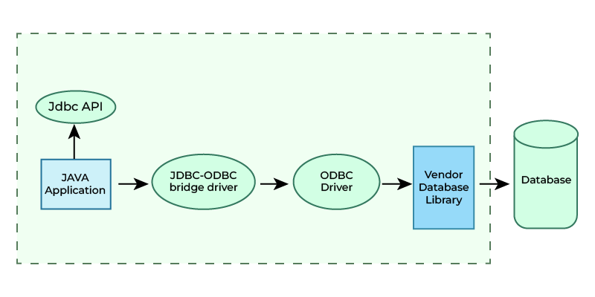
JDBC-ODBC Bridge Driver - Type 1 Driver
Type-1 driver or JDBC-ODBC bridge driver uses ODBC driver to connect to the database.
The JDBC-ODBC bridge driver converts JDBC method calls into the ODBC function calls.
Type-1 driver is also called Universal driver because it can be used to connect to any of the databases.

Slide 16
JDBC-ODBC Bridge Driver - Type 1 Driver
Advantages
This driver software is built-in with JDK so no need to install separately.
It is a database independent driver.
Disadvantages
As a common driver is used in order to interact with different databases, the data transferred through this driver is not so secured.
The ODBC bridge driver is needed to be installed in individual client machines.
Type-1 driver isn't written in java, that's why it isn't a portable driver.

Slide 17
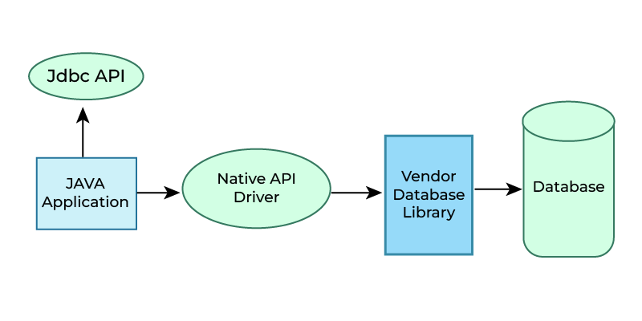
Native-API Driver - Type 2 Driver ( Partially Java Driver)
The Native API driver uses the client -side libraries of the database. This driver converts JDBC method calls into native calls of the database API. In order to interact with different database, this driver needs their local API, that's why data transfer is much more secure as compared to type-1 driver.
This driver is not fully written in Java that is why it is also called Partially Java driver.

Slide 18
Native-API Driver - Type 2 Driver ( Partially Java Driver)
Advantage
Native-API driver gives better performance than JDBC-ODBC bridge driver.
More secure compared to the type-1 driver.
Disadvantages
Driver needs to be installed separately in individual client machines
The Vendor client library needs to be installed on client machine.
Type-2 driver isn't written in java, that's why it isn't a portable driver
It is a database dependent driver.

Slide 19
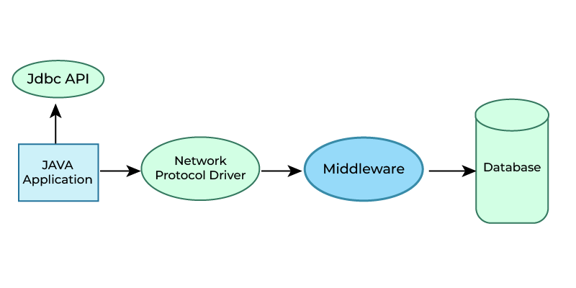
Network Protocol Driver - Type 3 Driver (Fully Java Driver)
The Network Protocol driver uses a middleware (application server) that converts JDBC calls directly or indirectly into the vendor-specific database protocol. Here, all the database connectivity drivers are present in a single server, hence no need of individual client-side installation.

Slide 20
Network Protocol Driver - Type 3 Driver (Fully Java Driver)
Advantages
Type-3 drivers are fully written in Java, hence they are portable drivers.
No client side library is required because of application server that can perform many tasks like auditing, load balancing, logging etc.
Switch facility to switch over from one database to another database.
Disadvantages
Network support is required on client machine.
Maintenance of Network Protocol driver becomes costly because it requires database-specific coding to be done in the middle tier.

Slide 21
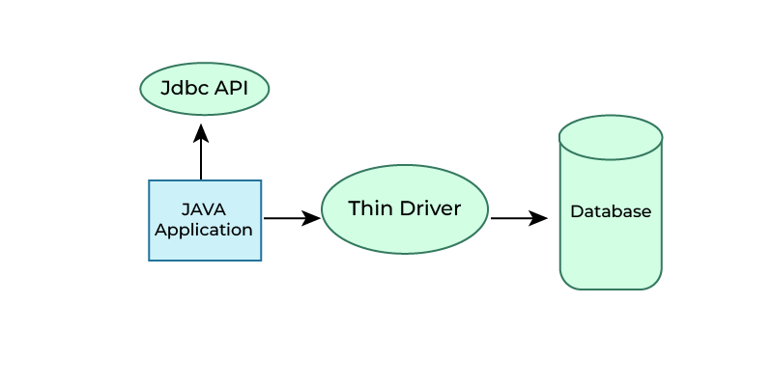
Thin Driver - Type 4 Driver (Fully Java Driver)
Type-4 driver is also called native protocol driver. This driver interacts directly with database. It does not require any native database library, that is why it is also known as Thin Driver.

Slide 22
Thin Driver - Type 4 Driver (Fully Java Driver)
Advantages
Does not require any native library and Middleware server, so no client-side or server-side installation.
It is fully written in Java language, hence they are portable drivers.
Disadvantage
If the database changes, a new driver may be needed.

Slide 23
Maven Integration with Eclipse
What is Maven?
Maven is a build automation tool used primarily for Java projects.
It uses a file called pom.xml to manage project dependencies and build configuration.
Steps to Integrate:
Install the Maven plugin in Eclipse (usually preinstalled in newer versions).
Create a Maven Project:
File > New > Maven Project
Define pom.xml with dependencies and project structure.
Eclipse will auto-download all required libraries from the Maven Central Repository.

Slide 24
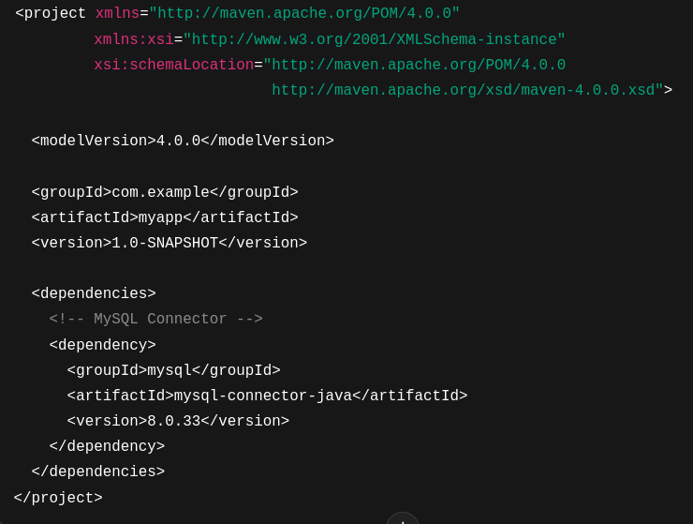
POM.xml Overview
What is pom.xml?
Project Object Model – defines project structure, dependencies, and build configuration.

Slide 25
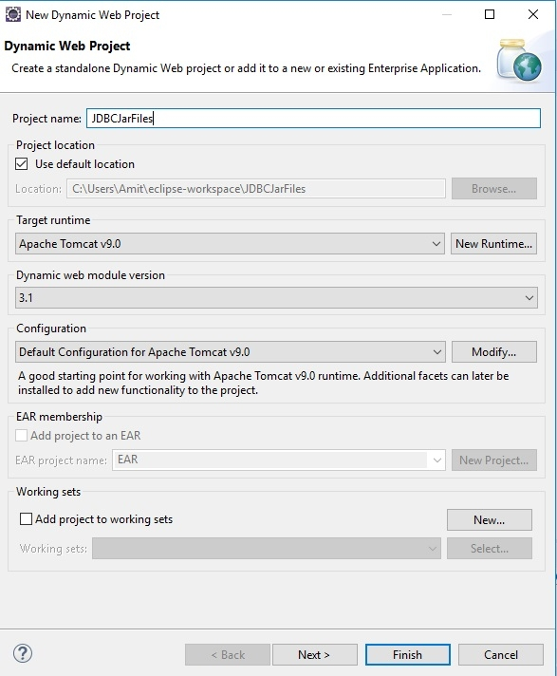
JDBC with MySQL
Step1: Create a dynamic web project with some name in Eclipse.
Step2: After pressing the Dynamic Web Project, a new window will open. Now give the project name. The screenshot is as follows:

Slide 26
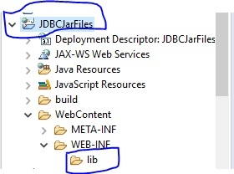
JDBC with MySQL
Step 3: Therefore, I have a project name JDBCJarFiles and in WEB-INF, there is a lib folder. You can add JDBC jar files in lib folder. Now, paste the jar files here. The screenshot is as follows:

Slide 27
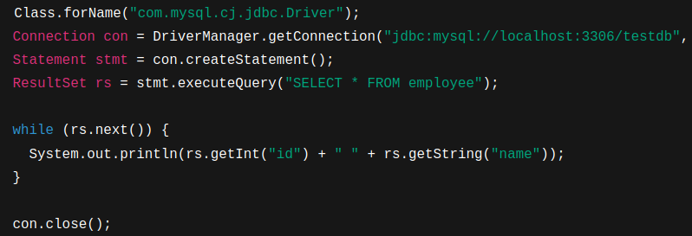
JDBC with MySQL
JDBC with MySQL
Steps:
Add JDBC driver (MySQL Connector/J)
Establish connection
Execute queries
Close resources

Slide 28
Best Practices
When using JDBC, there are some best practices to keep in mind:
Always use parameterized SQL statements to avoid SQL injection attacks.
Use connection pooling to improve performance and scalability.
Use the appropriate type of JDBC driver for your specific needs.
Always close resources (e.g., Connection, Statement, ResultSet) when they are no longer needed.
By following these best practices, you can ensure that your JDBC-based application is secure, scalable, and efficient.

Slide 29
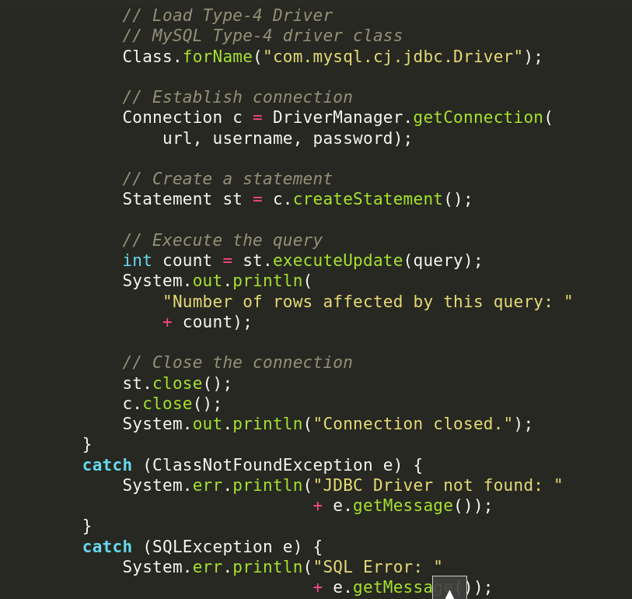
Code Snippets
Loads the MySQL JDBC driver using Class.forName() and establishes a database connection with DriverManager.getConnection()
Creates a Statement object to execute a SQL query stored in the variable query
Executes the query using executeUpdate() and prints how many rows were affected.
Closes the resources Statement and Connection and handles ClassNotFoundException and SQLException errors gracefully.

Slide 30
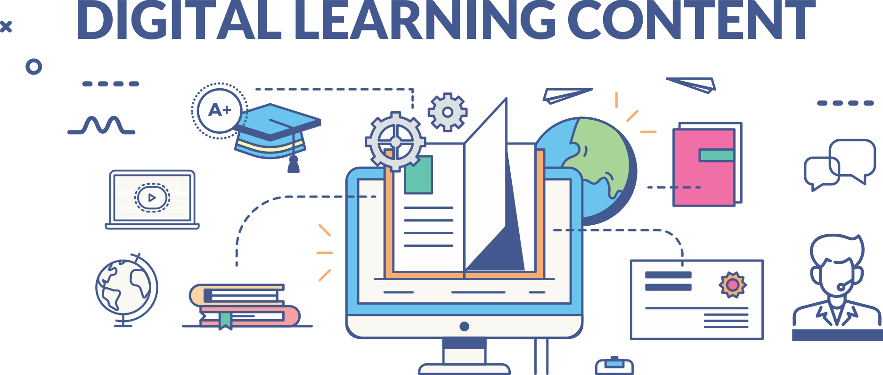

www.paruluniversity.ac.in

